Slide 1
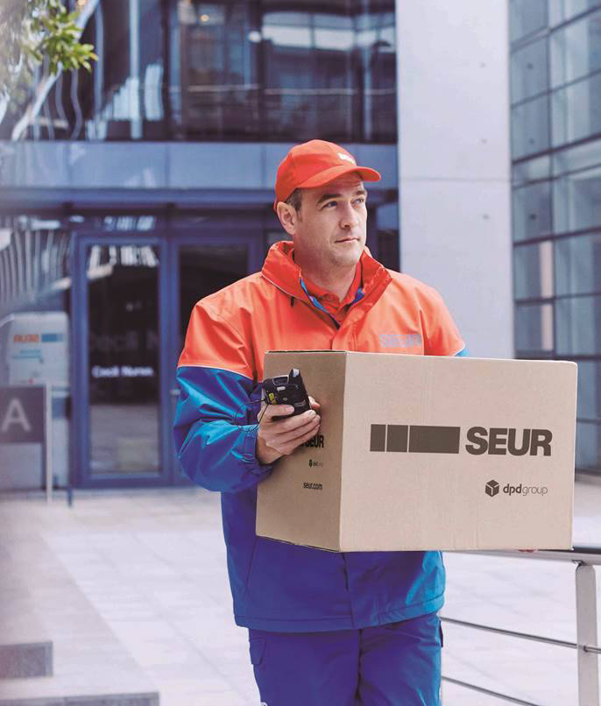
Corporate
Presentation 2017

Slide 2
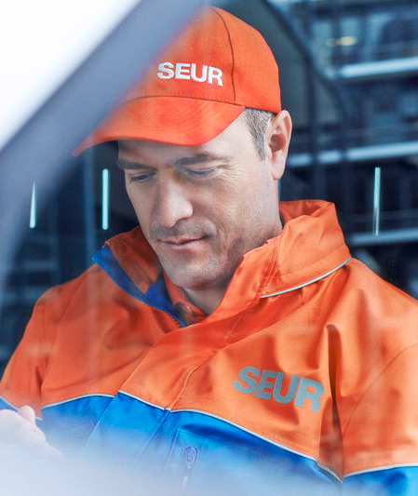
Content
1
We are SEUR
DPDgroup
Innovative solutions
SEUR, the best partner
2
3
4

Slide 3
We are SEUR
1

Slide 4
We are SEUR
Reference company
Committed to our customers
Pioneer company in the industry since 1942
The structure with largest network in Spain and Portugal
Multi-expert mindset
International operational capacity provides a worldwide service through the GeoPost network
Pro-activity in delivery solutions
Adaptation to every customer’s need
Proximity and cooperation
Quality, reliability and customer’s full satisfaction
Highest client satisfaction ratio in the market: above 90%
Market share above 22%

Slide 5
We are SEUR: facts and figures
Number of parcels we deliver every single day
Total revenue in 2016
(millions)
Deliveries in 2016 (millions)
€636
107MM
Delivery experts
Fleet
350,0000
7,100
4100 vehicles

Slide 6
We are SEUR
Multi-expert Mindset
Global logistics
Freight parcels
Express parcel
Documents
Business Areas
Companies
SME
SOHO
Private
Customers
B2B
B2C
C2B
C2C
Transactions
National (Spain and Portugal)
International
Coverage

Slide 7
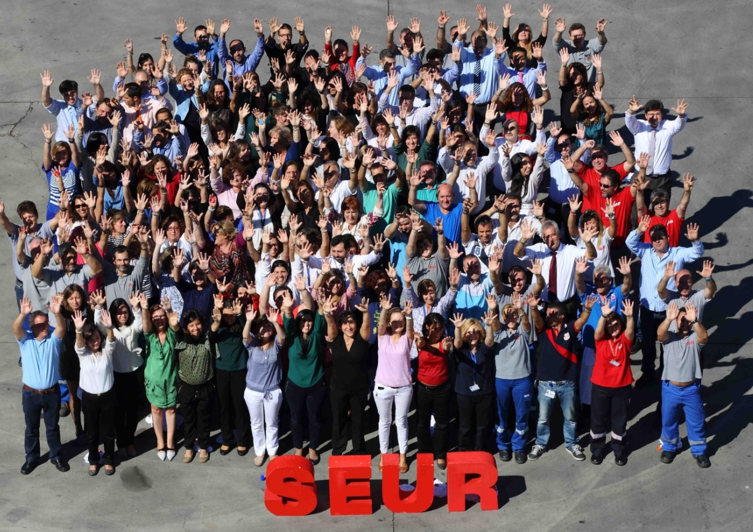
We are SEUR
The best team
Sales School
More than 1.400 professionals
trained in Spain and Portugal
2016. First promotion: 471 students
Leaders School
II Edition: 80 students
Total training hours: +8.000

Slide 8
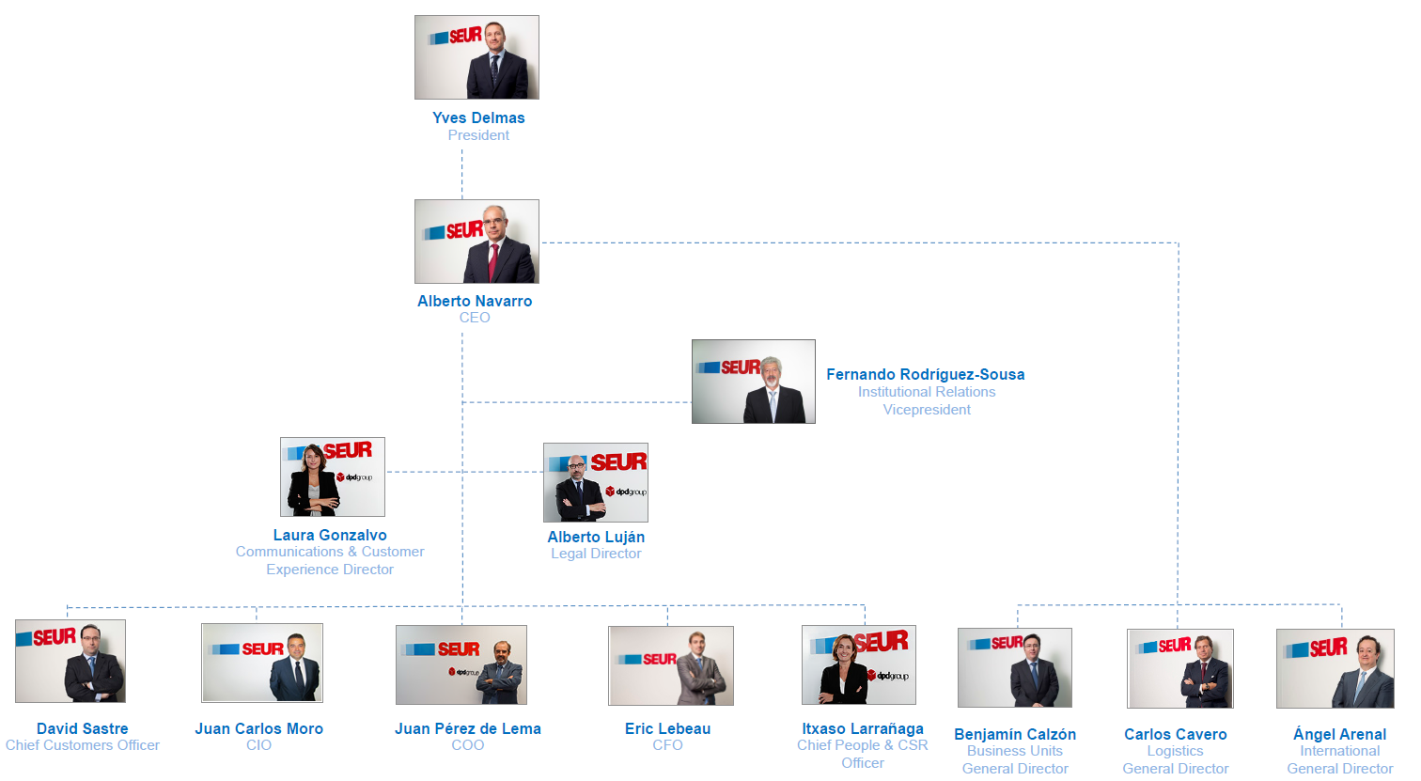
We are SEUR
Our team

Slide 9
DPDgroup
2

Slide 10
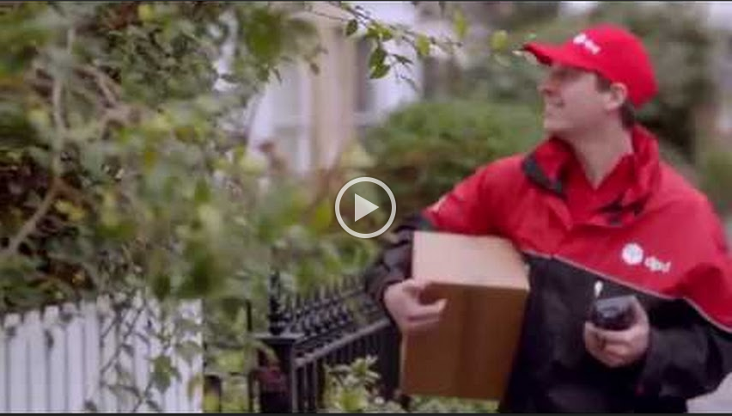
A new identity
Enlace a microsite y vídeo externo

Slide 11
Our brand architecture
Our group
Our holding
Our international network
Our commercial brands
Our solutions

Slide 12
Second in the european
CEP market

Slide 13
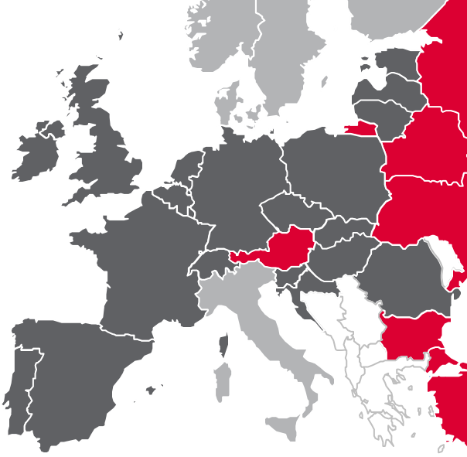
#1 in Spain, UK, Poland, Estonia y Lithuania
#1 in B2C, domestic parcel delivery and international road services
#2 in Portugal, France, Austria and Latvia
#2 in parcel services in Europe
Majority shareholding
Minority shareholding
Agreement

Slide 14
DPDgroup
Number of parcels we deliver every single day
Total revenue in 2016
(billions)
Deliveries in 2016 (millions)
€6,200
1,100
Delivery experts
Fleet
4 MM
60,000
38,000 vehicles

Slide 15
Accelerated development in the B2C market
+22% growth in 2016
European operator with highest growth
30% of turnover
+25% growth in 2016
.

Slide 16
Strong international development
150 million euros
10% growth in 2016
13% of the volumes
18% volume growth in 2016

Slide 17
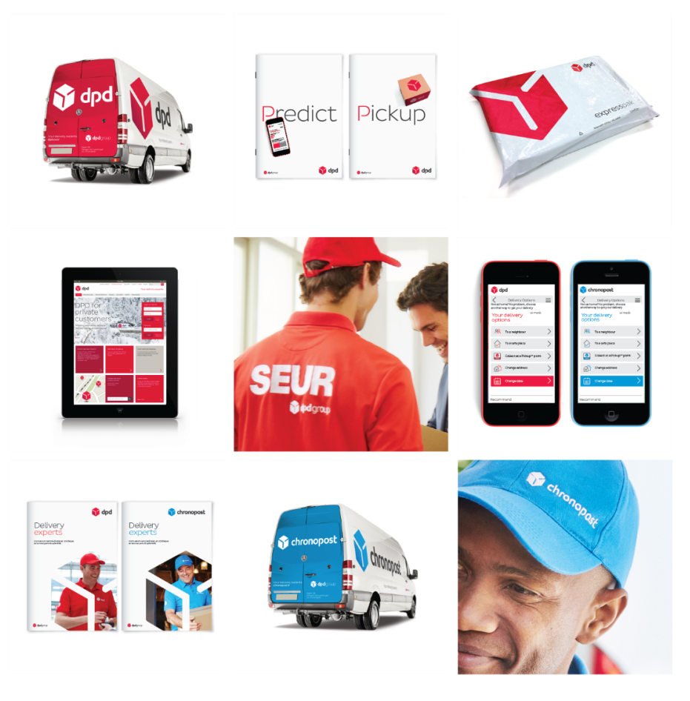
7

Slide 18
3
Innovative
solutions

Slide 19
A complete and differential offer
The e-Buyer has the last Word to receive his parcel, when, where and how he wants
When
NextDay
SameDay
SaturDay
SunDay
Now
How
SEUR Predict 1H:
Interactive Deliveries
Follow your shipment
Manage your absence
Where
At home
SEUR Pickup stores
e-Crossborder
Without borders with DPDgroup
DPD Predict 1H: interactive deliveries and follow your parcel in Europe
DPD Pickup: 26.000 stores in Europe
e-Devoluciones
Within 24 hours from pickup
At home or in SEUR Pickup stores

Slide 20
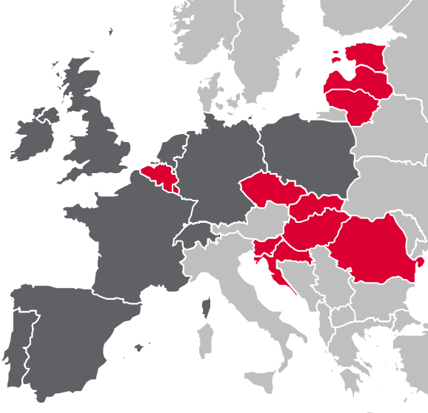
1 hour delivery window in 20 countries since 2015.
Additional solutions: changing delivery date.
50.000 shipments/day in Spain.
Available
Coming soon

Slide 21
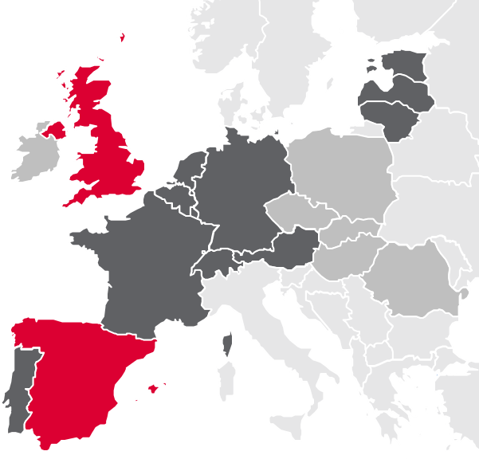
#1 in Pickup shops across Europe as of December 2016.
# countries covered by Pickup network.
26.000
14
Pickup shops available in Spain in 2016.
1.400
2014: 16 000 Pickup shops
2015: 22 000 Pickup shops
2016: 26 000 Pickup shops

Slide 22
Our commitment DrivingChange™
4

Slide 23
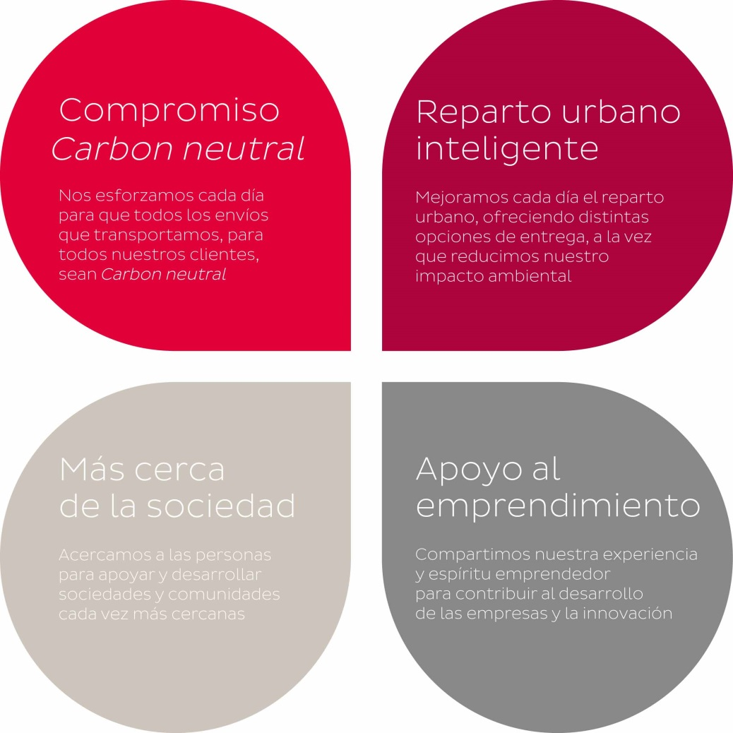
Our conviction
We believe in being
a responsible partner
to the people,
businesses, and
communities we work
closely with

Slide 24
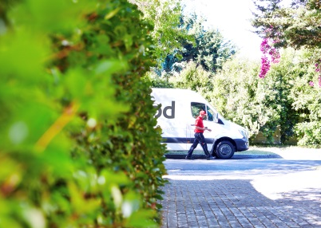
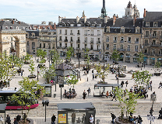
Four axes
Reflect and demonstrate our position as delivery experts and our commitment to being a
pragmatic and responsible business
Our commitment to neutralising our carbon footprint:
Objective to reduce our transport related GHG emissions per parcel by 10% by 2020
Half of DPDgroup’s fleet is less than 5 years old
Adapting to modern ways of living in urban environments:
Predict available in 22 European countries
95% of Europeans within 15 minutes of a Pickup point
Innovation inside and outside of our business:
75 Quality Awards projects presented by group employees from 18 countries in 2015
Partnership with Ashoka
Making a positive contribution on the communities we’re closest to:
Over 5000 employees participated in community actions in 2014
Over 300 associations supported

